Slide 1

DDOS ATTACK IDENTIFICATION
AI-511 Machine Learning
INTERNATIONAL INSTITUTE OF INFORMATION TECHNOLOGY BANGALORE
16th December, 2022
Team Name :- WHIZZ
Team Members:- Anisha Rani(MT2022153)
Kshitija Shah(MT2022147)
Under guidance of:- Harshita Soni

Slide 2
Problem Statement
We are given various features regarding events in a network. We need to identify if those events were related to a DDoS attack, or was the network intrusion benign.
This is a binary classification problem involving approximately 80 features and 16 million training rows.
The metric to be used is the F1 score. The dataset is imbalanced.

Slide 3
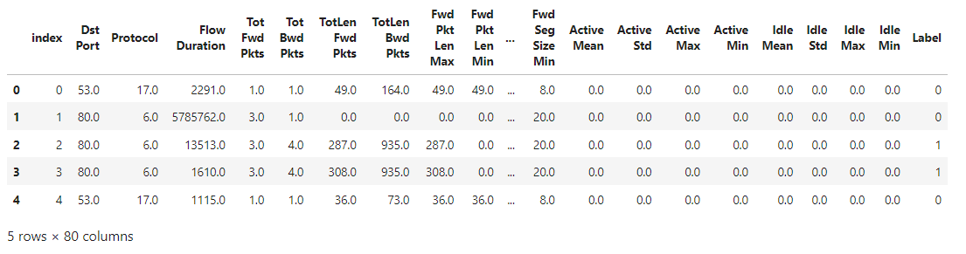
Dataset Overview
Dataframe head overview using dask library.

Slide 4
1.Preprocessing Overview:
Analysing the size of the training data provided.
Analysing columns and data type.(79 columns :float64 ,Label:int64)
Dropping columns with single unique values.
Handling columns with infinite values.
Understanding data distribution.(Imbalance data)
Finding Correlation and reducing the feature set.

Slide 5
1.1 Observing and Cleaning the DATA
Check For NULL values for the features provided.
Check for special characters (missing values) in the data.
Observing the unique value counts for each feature.
8 columns with single unique value is dropped.
Dropped index.
Dropped the columns with single unique value.
['index','Bwd URG Flags' , 'Fwd Byts/b Avg' , 'Fwd Pkts/b Avg','Fwd Blk Rate Avg','Bwd Byts/b Avg',’ Bwd Pkts/b Avg','Bwd Blk Rate Avg','Bwd PSH Flags’] using nunique().compute().
Checking the distribution of data using describe().
Replacing ‘inf’ with ‘nan’(2 columns-flowbytes/s,flowpack/s) discarding those rows,as the distribution of those rows are similar to the label distribution considering the fact that the data is imbalanced.
Raw data: Features 80 features after processing-71
rows:15173222 rows: 15139506

Slide 6
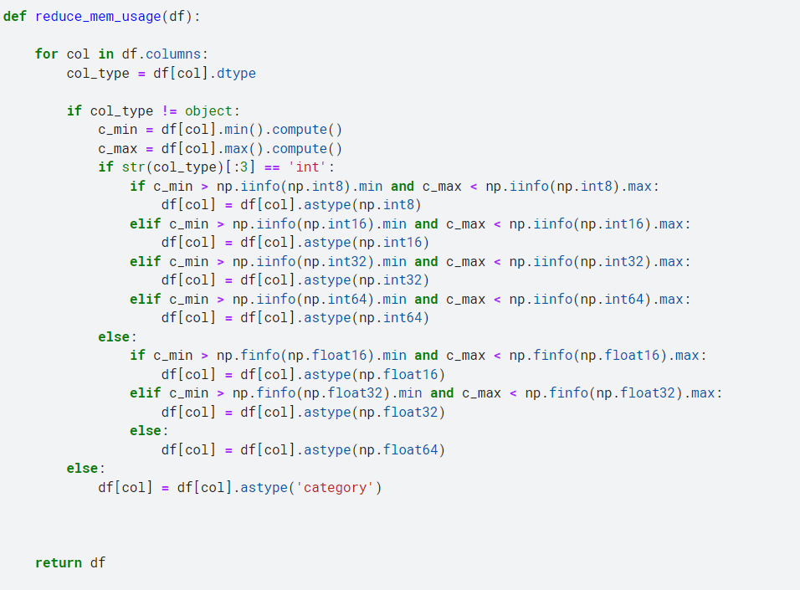
1.2 SIZE Optimization:
Observed the data type for each feature and compared with the min and max range of type the column falls in. Reduced the data type of each column accordingly.
Initial data size: 7.45GB
Reduced data size: 5.77GB

Slide 7
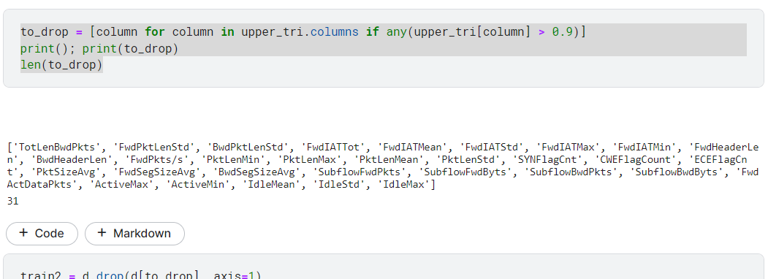
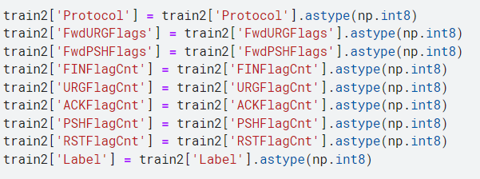
1.3 Correlation and data type Conversion:
Removed those column which are highly correlation (corr > 0.9).
31 columns filtered out from the upper triangle of correlation matrix.
Further analysed columns with 2 unique values(i.e 0,1 )INT-(9 column)
Converted FLOAT to INT8
SIZE:
Before:5.77GB After:-3.06GB

Slide 8
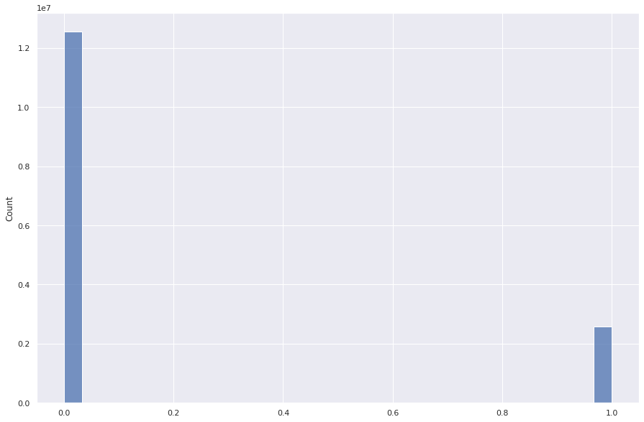
1.4 IMBALANCE DATA CHECK
HIST PLOT FOR LABEL

Slide 9
1.5 Dimentionality Reduction
To determine the importance of features over the predicted outcome we have removed the irrelevant variables and current dataset contains 40 features. Here, in our case we need to identify the impact of a variable over the Label column. Ideally, the variables with less importance can be ignored in model building. After splitting the training data to Xtrain and Ytrain(Label) we tried to optimize the data further :-
Experiments Conducted And Challenges Faced
We applied PCA to the training and testing dataset in order to reduce the dimension of features to 25 .
But due to fit_transform ,although the size of features reduce ,we did not see any significant reduction in file size.
Pandas still could’nt read the entire Xtrain due to increase in size of large dataset after standardization.
Apart from some hardware constraints due to ram overflow(as the dataset was large), the project itself was fun and we learned a lot from it.
Further we applied different models and observed the F1 scores along with hyperparameter tuning.

Slide 10
2. Training the model 2.1 Logistic Regression:
Logistic regression is a classification technique borrowed by machine learning from the field of statistics. Logistic Regression is a statistical method for analyzing a dataset in which there are one or more independent variables that determines an outcome. The intention behind using logistic regression is to find the best fitting model to describe the relationship between the dependent and the independent variable. For our dataset we have applied logistic regression initially with the default parameters and again with hyperparameter tuning. The F1 score was not convincing enough hence we moved on to other models.(as the dataset is highly imbalanced).
MODEL Accuracy : 0.8792837758378642
TEST DATA Accuracy:0.48205
HYPER parameter tuning
-GRID SEARCH CV
-RANDOMIZED SEARCH CV
Grid search –goes through all intermediate combination of hyperparameters.
Randomized goes through fixed no. of hyperparameters setting.

Slide 11
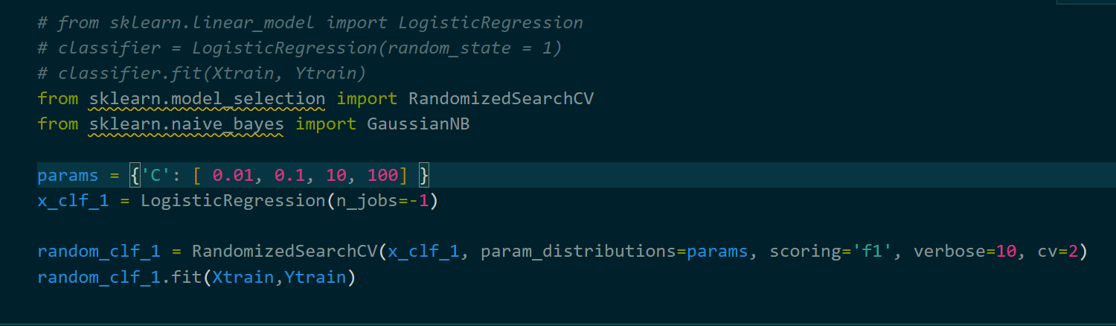
2.1.1 After applying randomized search cv
MODEL ACCURACY:
'C': 0.01
SCORE:0.44976703897311565
TEST DATA ACCURACY:0.39153

Slide 12
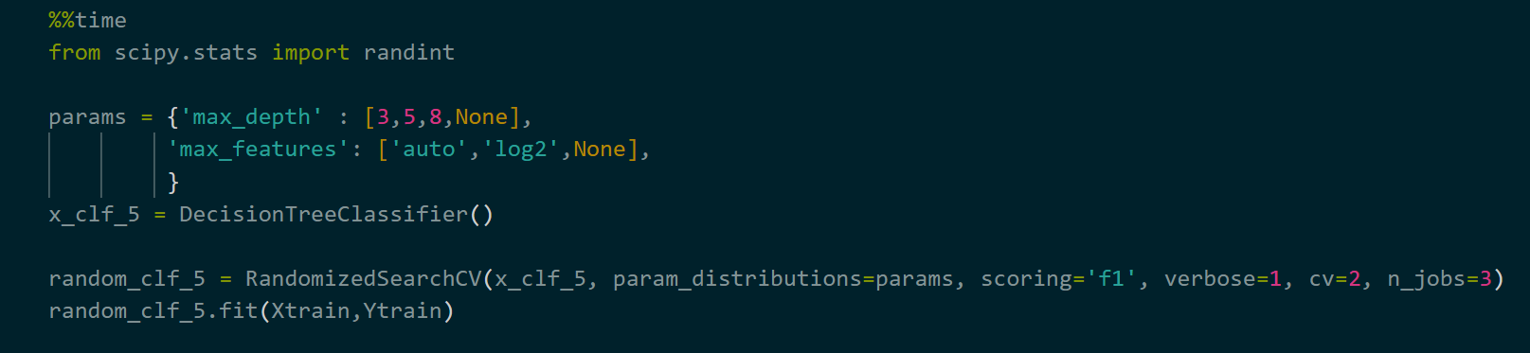
2.2 Decision Tree
Decision Trees (DTs) are a non-parametric supervised learning method used for classification. The goal is to create a model that predicts the value of a target variable by learning simple decision rules inferred from the data features. A tree can be seen as a piecewise constant approximation.
Hyperparameter Tuning:

Slide 13
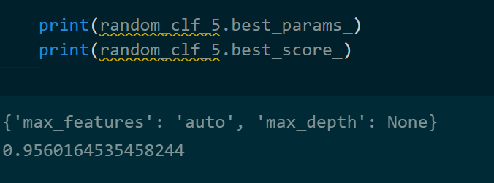
Best parameters and scores:
Hyperparameters output:
{'max_features': 'auto', 'max_depth': None}
MODEL f1 SCORE:
0.9560164535458244
TEST DATA SCORE:
0.95586

Slide 14
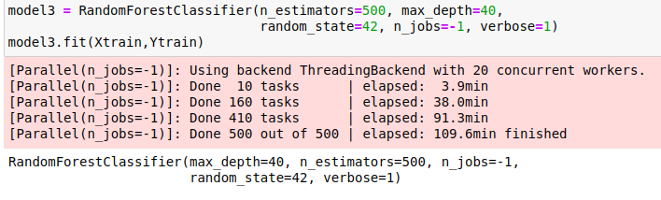
2.3 Random Forest
Random forest, like its name implies, consists of a large number of individual decision trees that operate as an ensemble. Each individual tree in the random forest spits out a class prediction and the class with the most votes becomes our model’s prediction.
TEST DATA SCORE : 0.9564

Slide 15
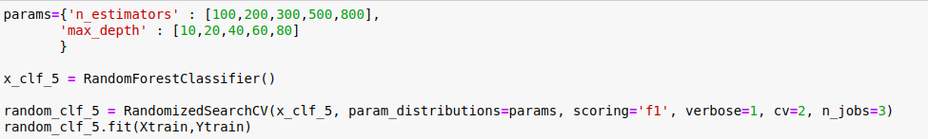
2.3.1 Random Forest with Hyperparameter Tuning
TEST DATA SCORE : 0.96539

Slide 16
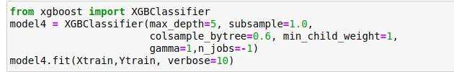
2.4 XGBOOST
XGBoost is an implementation of Gradient Boosted decision trees. Decision trees are created in sequential form. Weights play an important role in XGBoost. Weights are assigned to all the independent variables which are then fed into the decision tree which predicts results. The weight of variables predicted wrong by the tree is increased and these variables are then fed to the second decision tree. These individual classifiers/predictors then ensemble to give a strong and more precise model.
MODEL f1 SCORE: 0.969987
TEST DATA SCORE : 0.96963

Slide 17
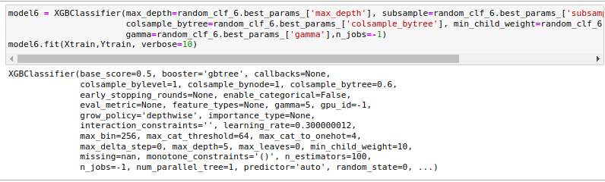
2.4.1 XGBOOST with Hyperparameter Tuning
MODEL f1 SCORE : 0.97001
TEST SCORE : 0.9697

Slide 18
Stochastic Gradient Descent
Stochastic gradient descent considers only 1 random point while changing weights unlike gradient descent which considers the whole training data. As such stochastic gradient descent is much faster than gradient descent when dealing with large data sets.
MODEL SCORE : 0.84067
TEST SCORE : 0.42185

Slide 19
Challenges Faced
Could not implement ADABOOST , as it does not have system optimizations.
AdaBoost is sensitive to noise data. It is highly affected by outliers because it tries to fit each point perfectly.
AdaBoost is slower compared to XGBoost.

Slide 20
References
https://medium.com/codex/do-i-need-to-tune-logistic-regression-hyperparameters-1cb2b81fca69
https://machinelearningmastery.com/hyperparameters-for-classification-machine-learning-algorithms/

Slide 21
Train-Test Data after preprocessing
https://www.kaggle.com/datasets/kshitijaashah/traintest?select=X_train.csv
https://www.kaggle.com/datasets/kshitijaashah/traintest?select=Y_train.csv
https://www.kaggle.com/datasets/kshitijaashah/traintest?select=X_test.csv

Slide 22
THANK YOU

